Slide 1
Engine room
Mud pump room
Sack storage room
Air compressor room
Switchboard room
Cantilever
Drill floor + Derek
Main deck
Mess room
Helideck

Slide 2
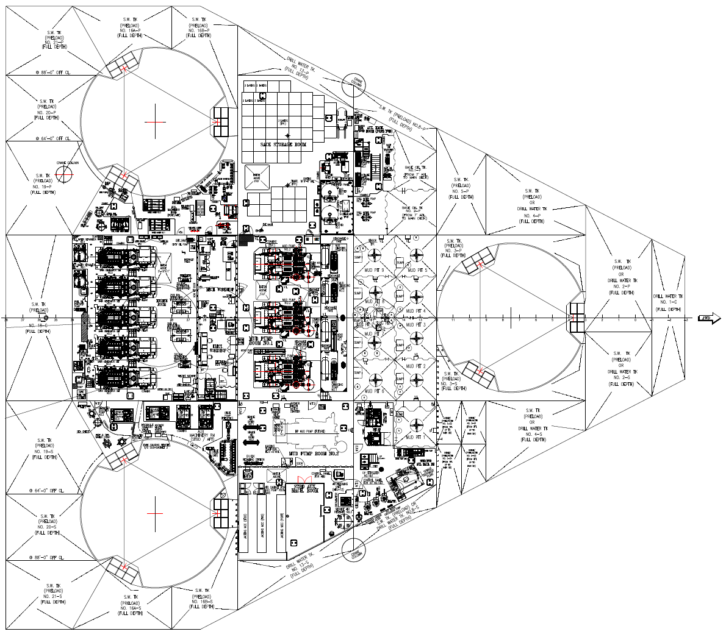
1: Engine room (x2)
2: Mud pump room (x2)
3: Sack storage room
4: Air compressor room
3
1
2
4

Slide 3
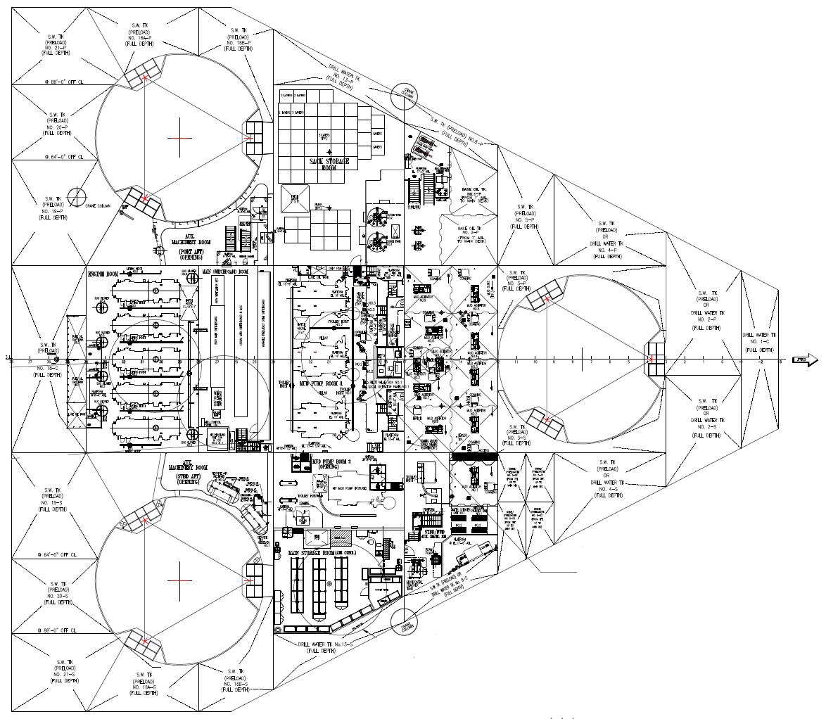
5: Main switchboard room
5

Slide 4
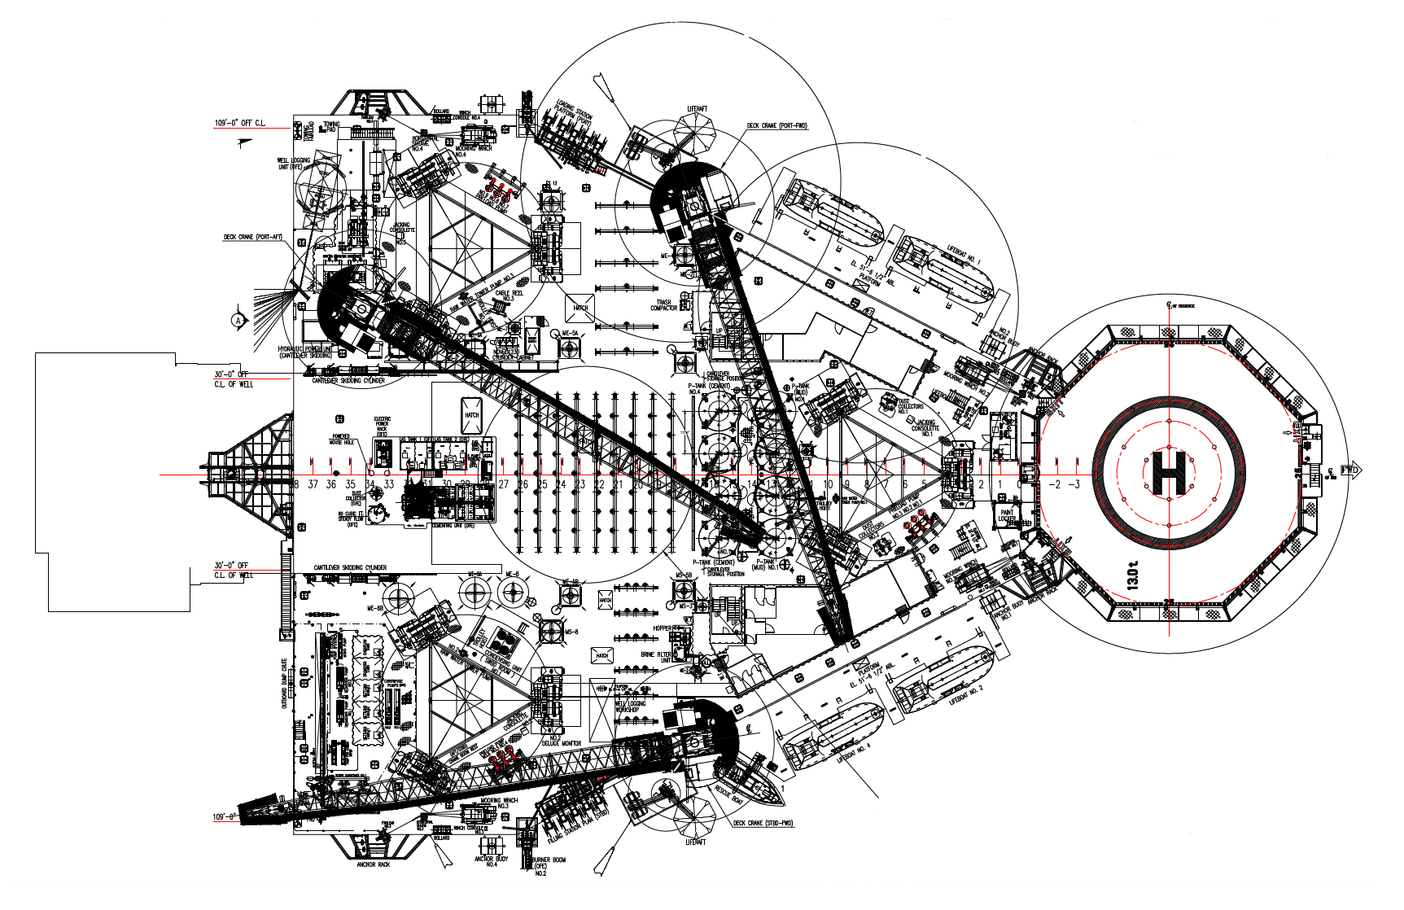
6: Cantilever
10: Helideck
6
10

Slide 5
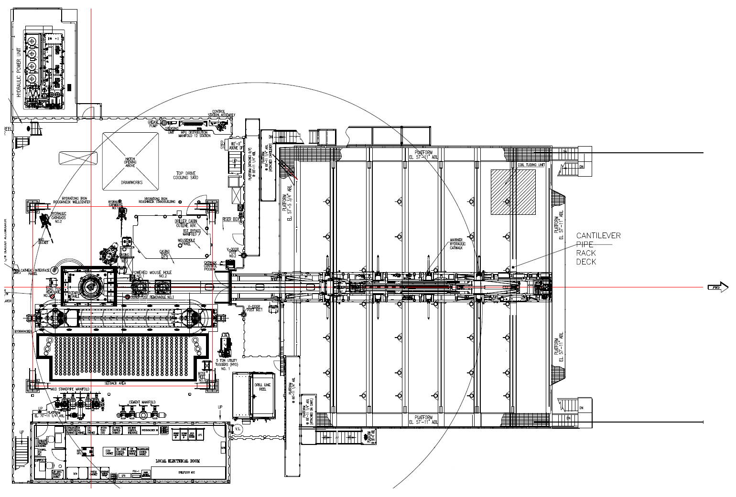
7: Drill floor + Derek
8: Main deck – Port & stbd
8
7
8

Slide 6
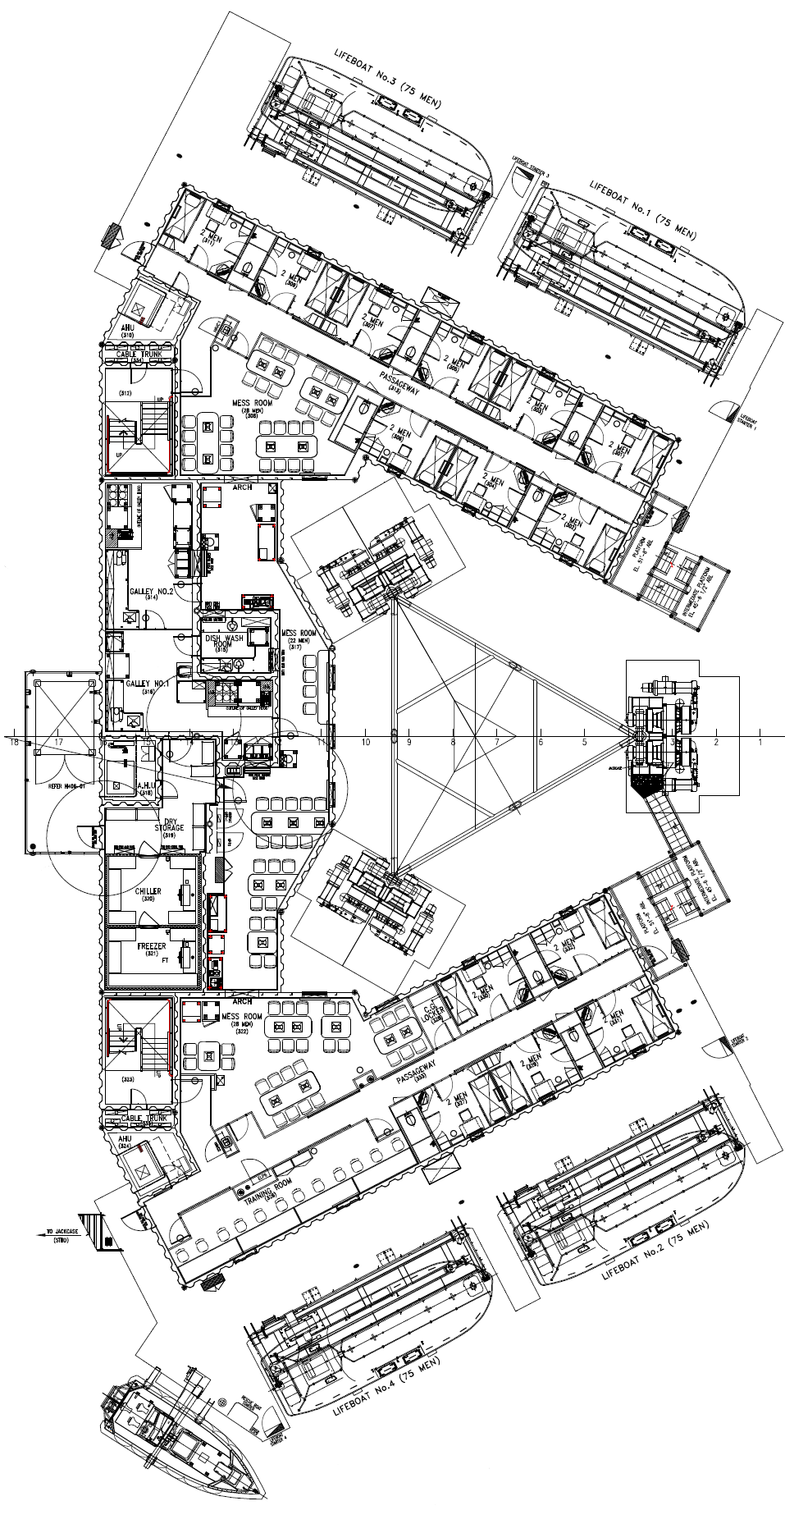
9: Mess room
9

